Slide 1
PEOPLE ANALYTICS
Tran Anh Tuan

Slide 2


PEOPLE ANALYTICS
Top Down Approach Using Xmind
Design UI Dashboard Using Visily
Power BI Using Power BI follow UI & Xmind

Slide 3
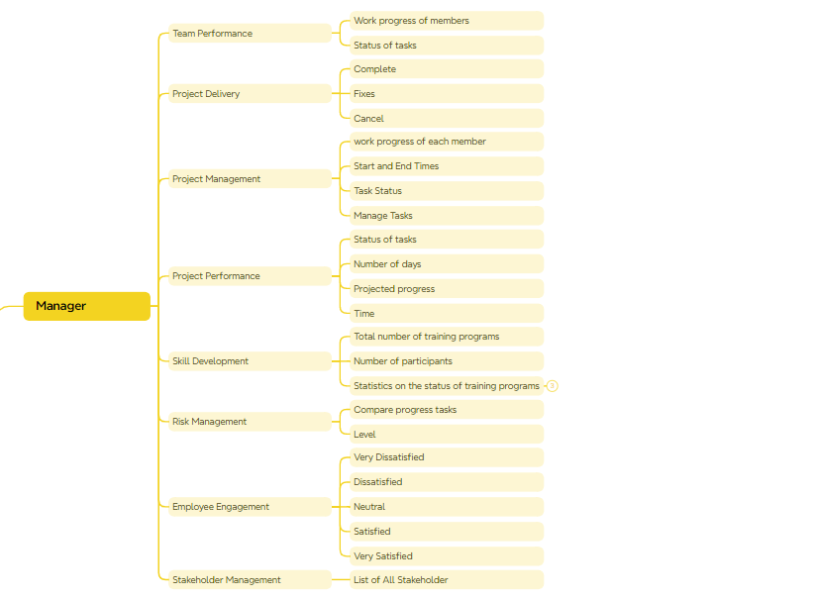
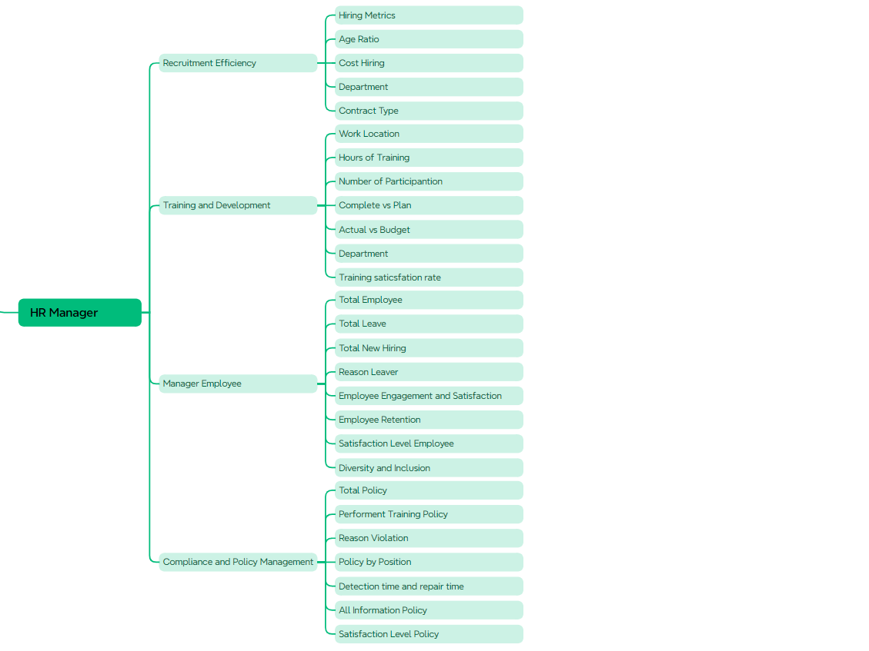
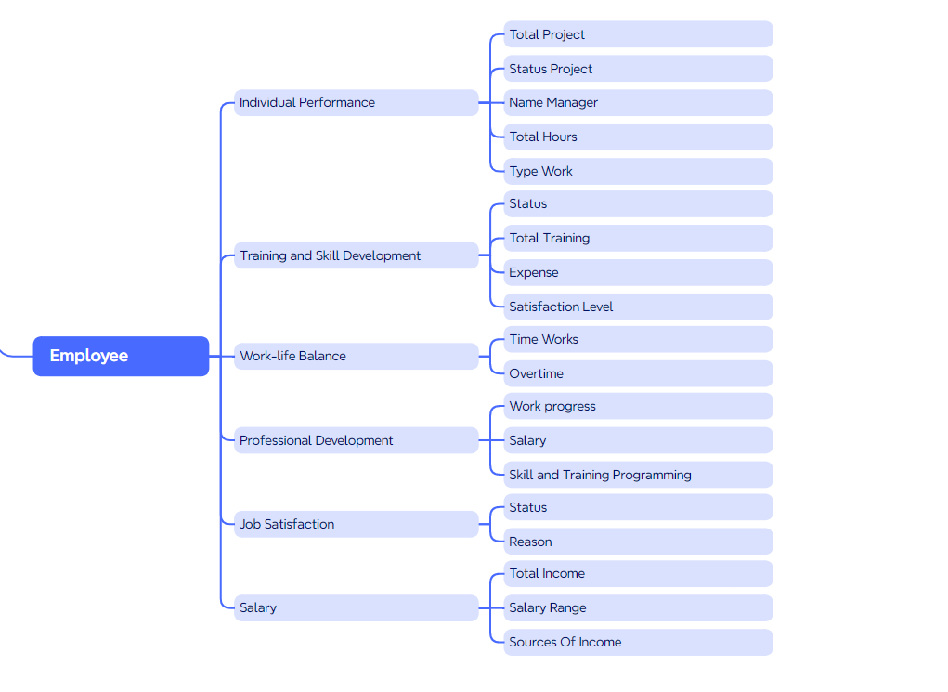
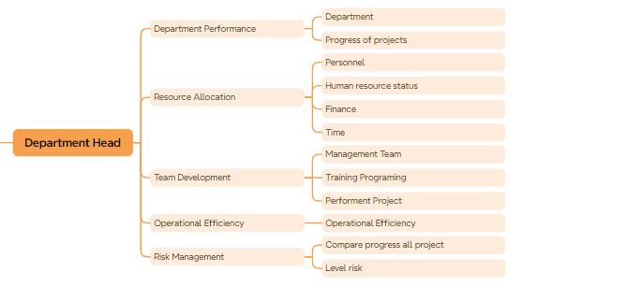
TOP DOWN APPROACH - Overview People Analytics
Link Png

Slide 4
TOP DOWN APPROACH - HR Manager

Slide 5
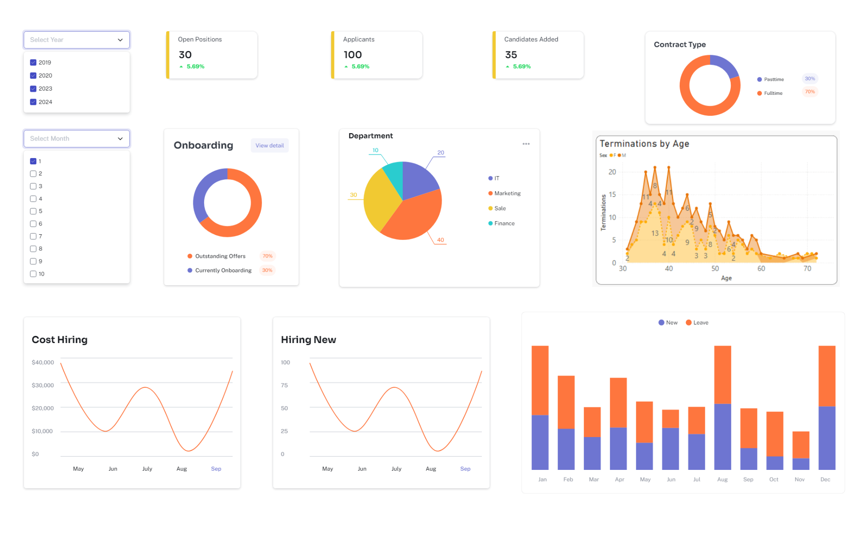
DESIGN UI DASHBOARD - Recruitment Efficiency

Slide 6
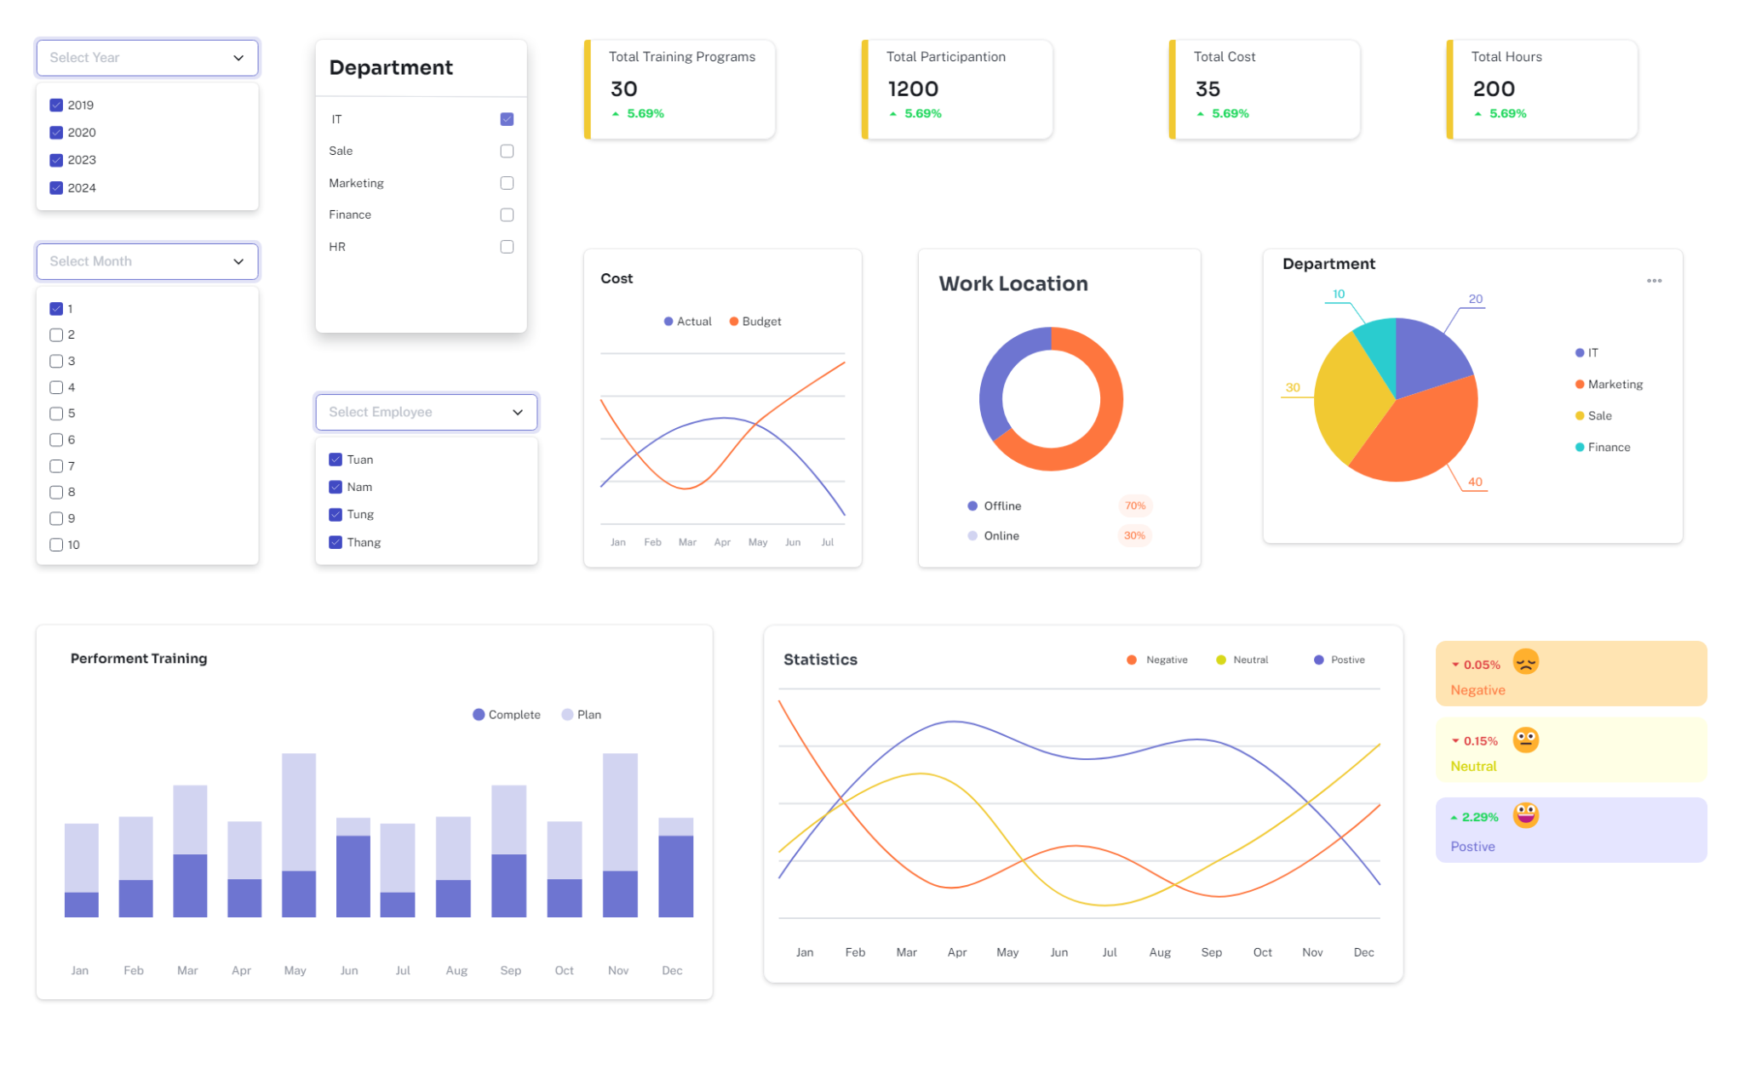
DESIGN UI DASHBOARD - Training and Development

Slide 7
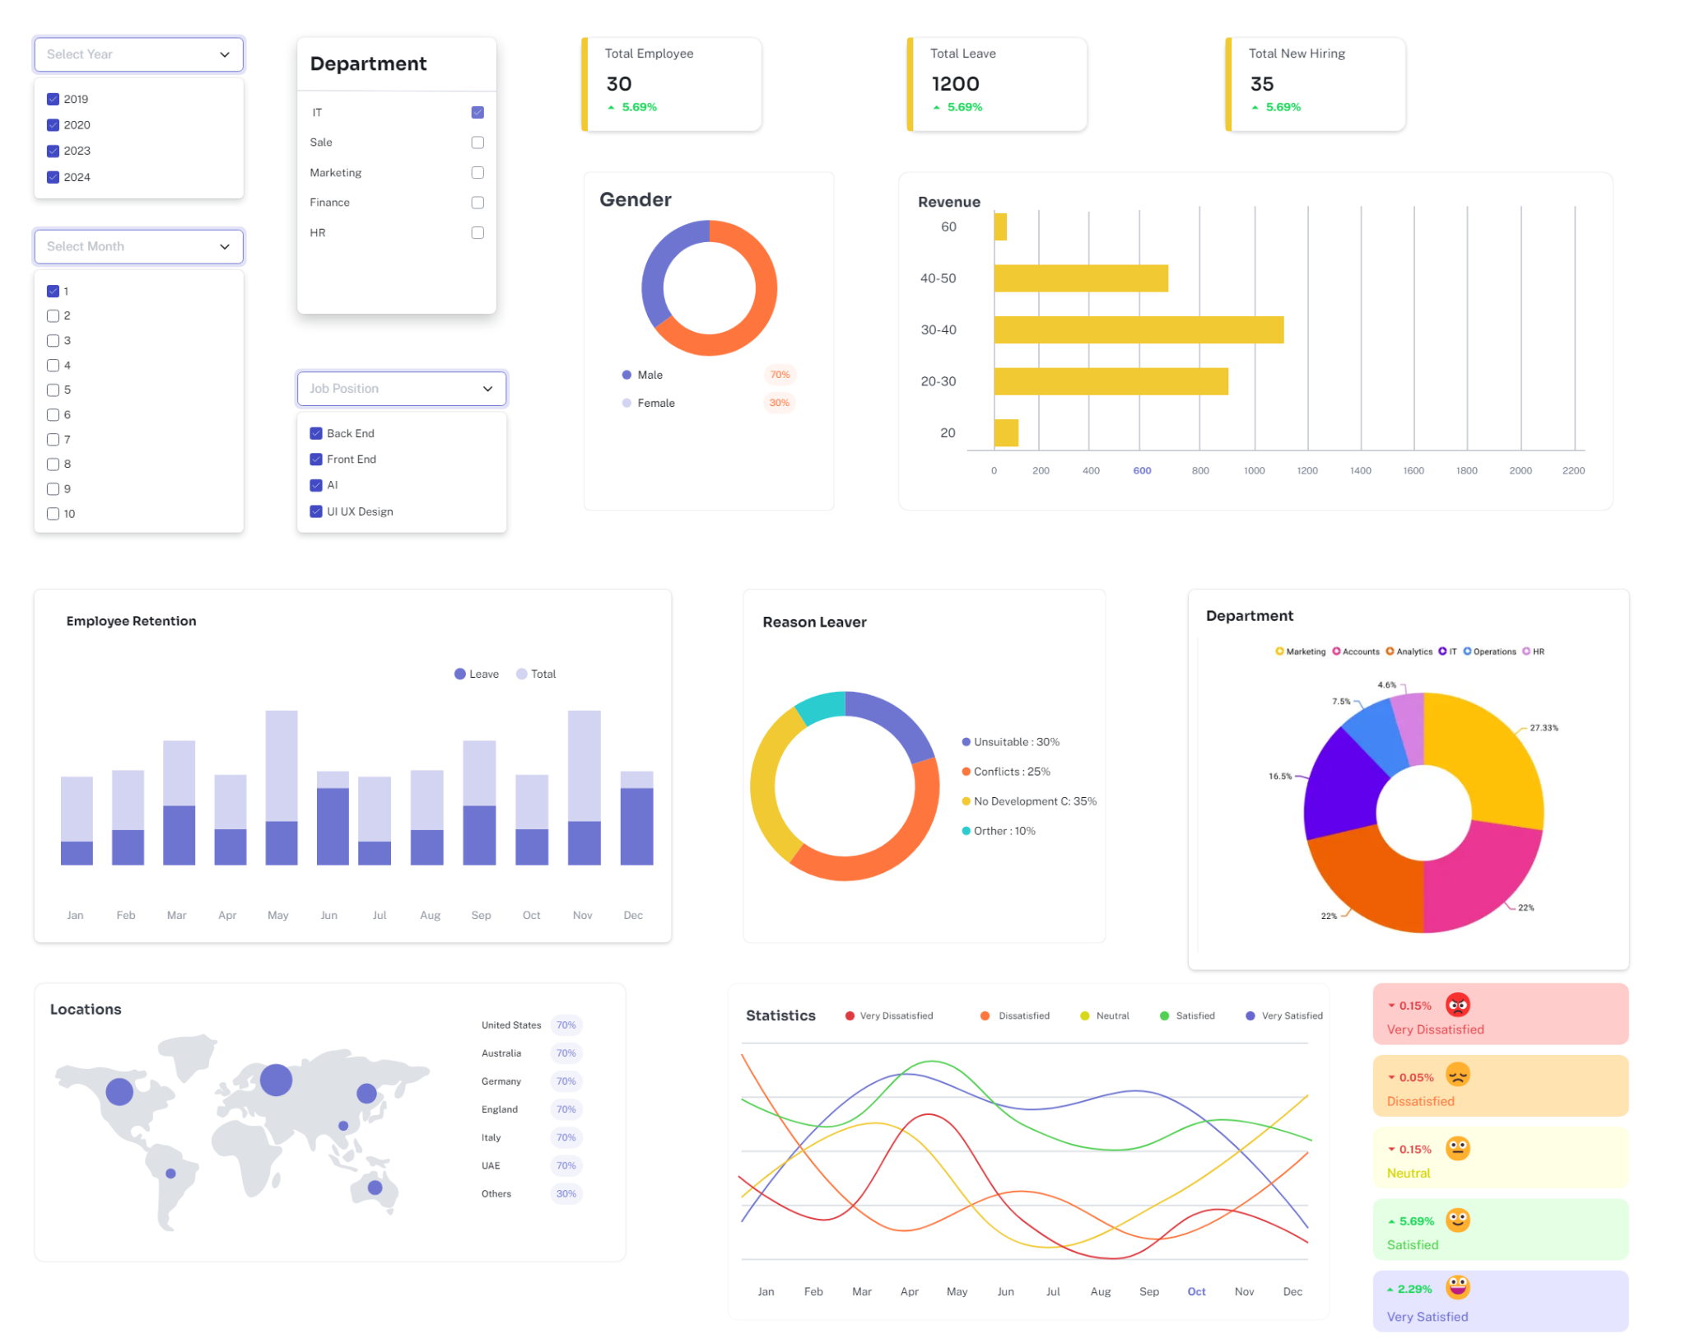
DESIGN UI DASHBOARD - Manager Employee

Slide 8
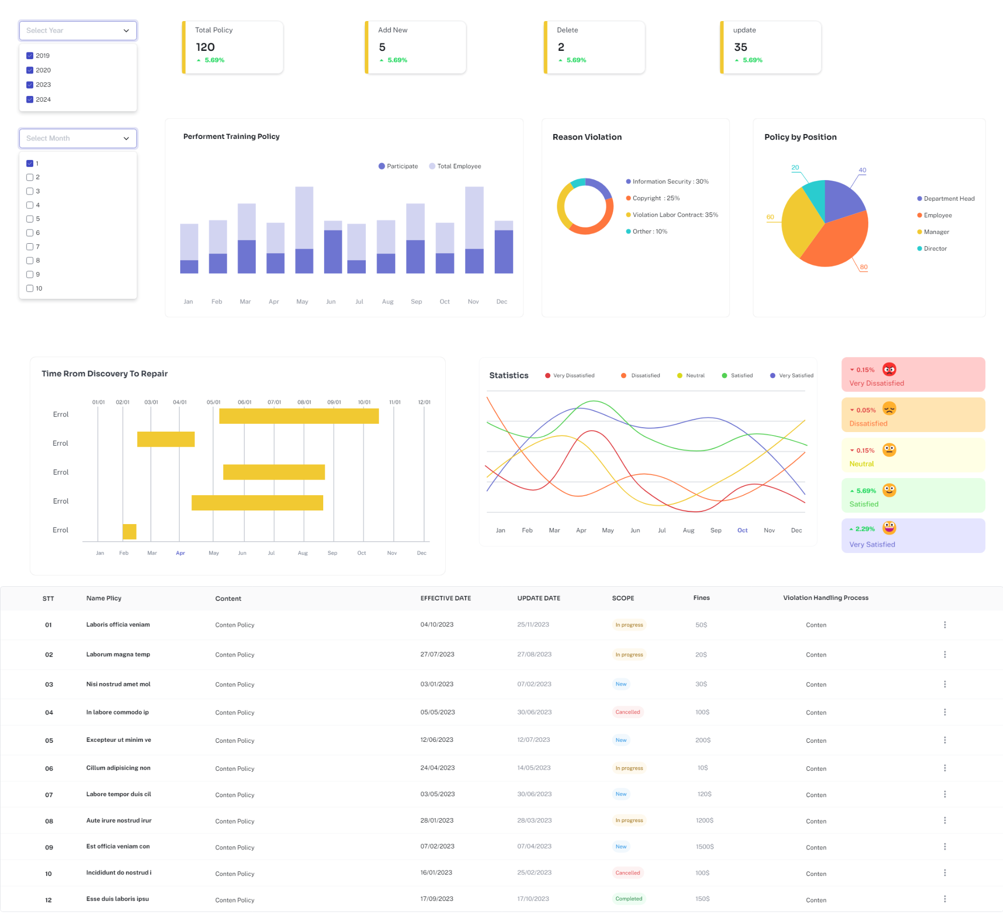
DESIGN UI DASHBOARD - Compliance and Policy Management

Slide 9
TOP DOWN APPROACH - Employee

Slide 10
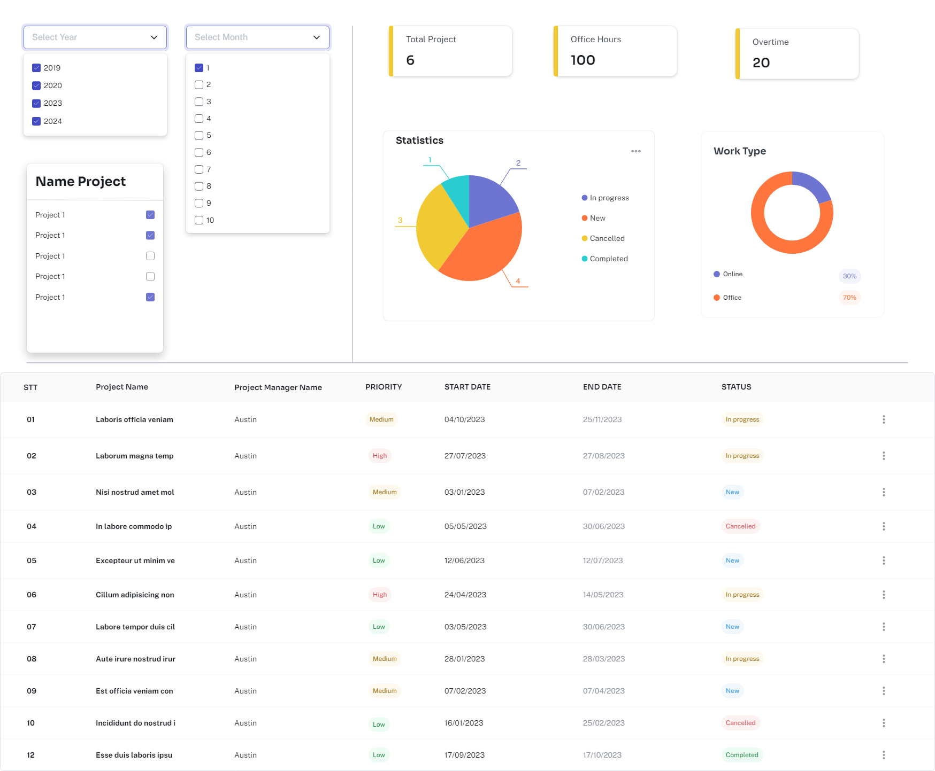
DESIGN UI DASHBOARD - Employee Performance

Slide 11
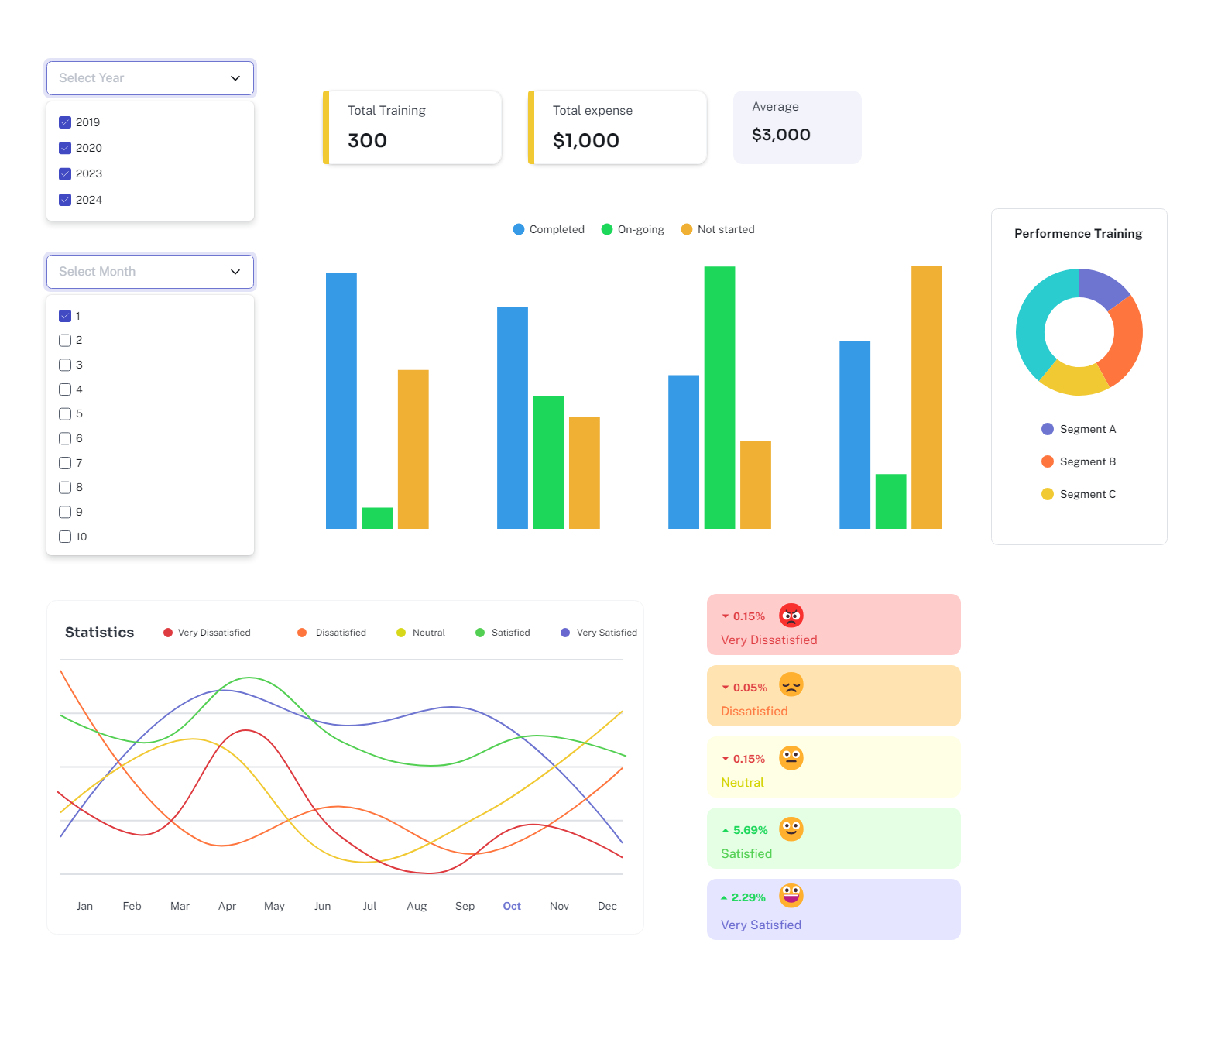
DESIGN UI DASHBOARD - Training and Development

Slide 12
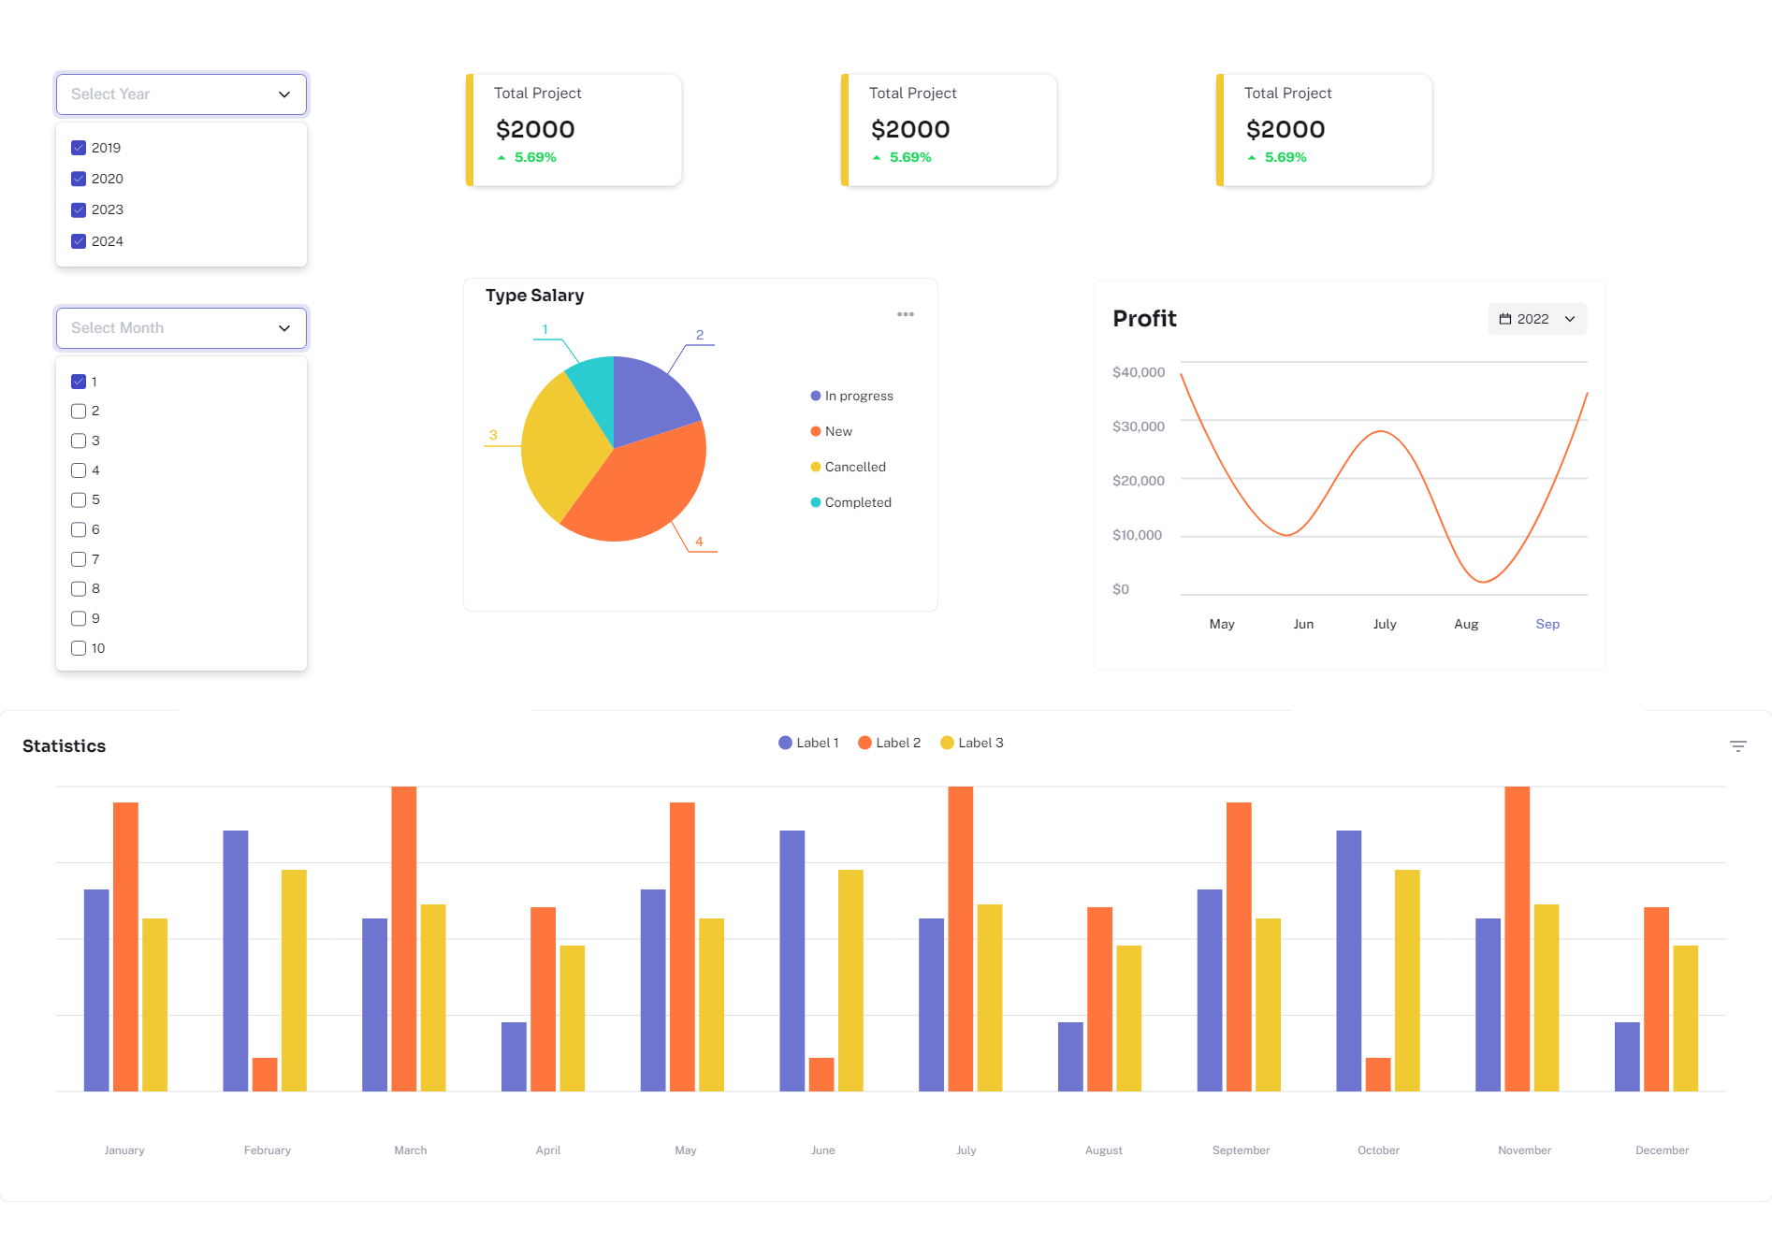
DESIGN UI DASHBOARD - Salary

Slide 13
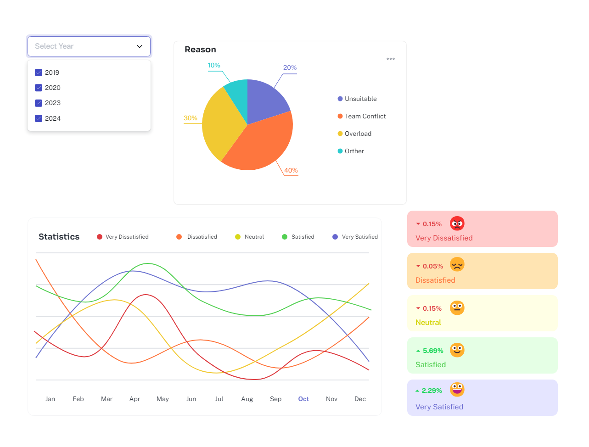
DESIGN UI DASHBOARD - Job Satisfaction

